Slide 1
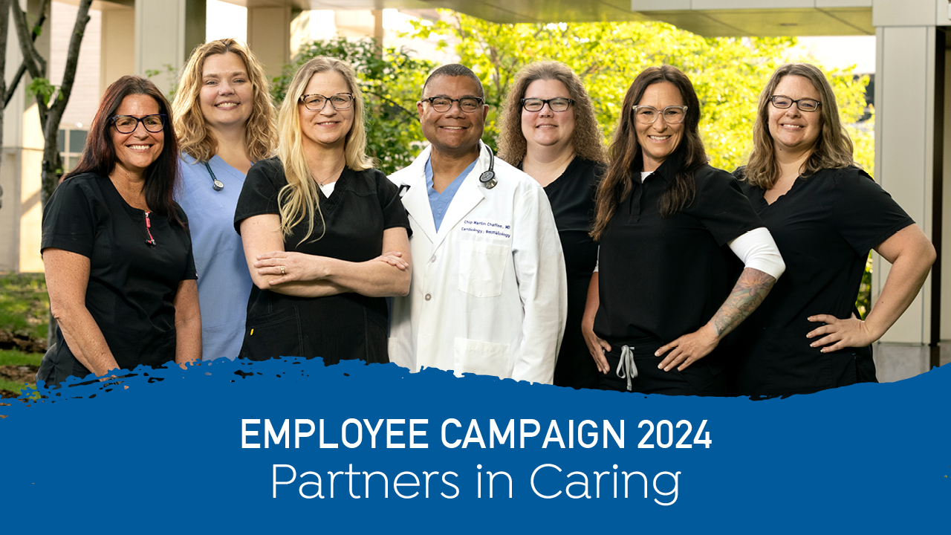
Notes:
Our Employee Giving Campaign runs May 1-31 and the fundraising priority is the greatest needs for each location, but as always, you can choose any fund you’re passionate about supporting!

Slide 2
Notes:
As rural Minnesotans, we face many ongoing healthcare issues that affect the well-being of our communities.
These include a shortage of medical professionals, a mental health crisis, and disparities in health equity.
As more challenges surface, it’s essential that we remain united in our mission to make rural life healthier.

Slide 3
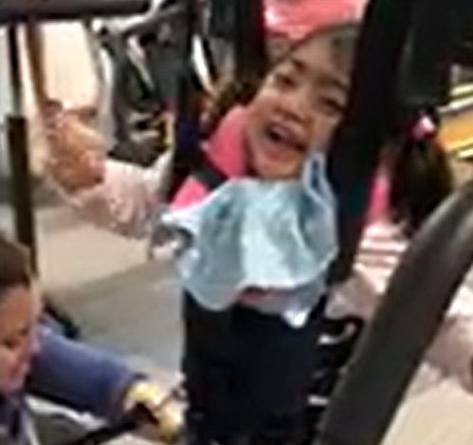
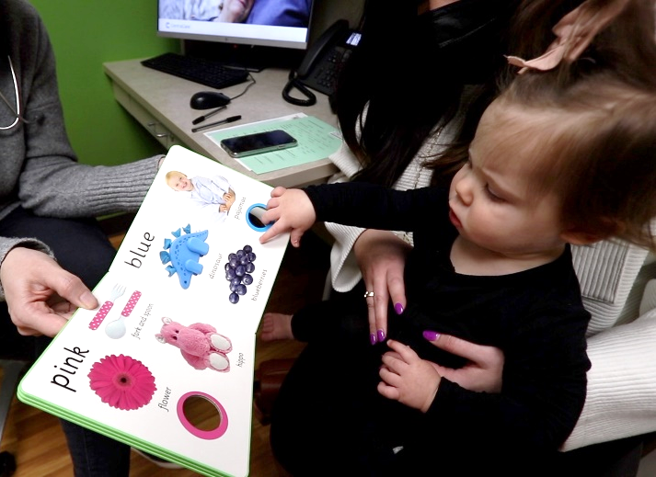
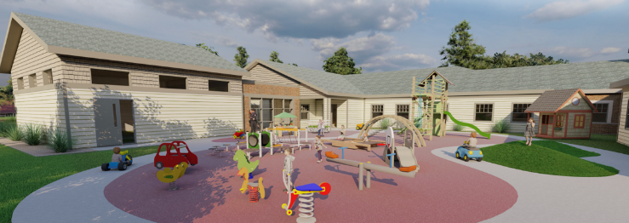
You are Helping Make Rural Life Healthier!
Notes:
At CentraCare, you have the opportunity to address these issues by donating to a cause you feel passionate about, making a lasting impact for your community.
Since 1998, Employee Giving Campaign donors have upheld the tradition of providing added care and support for patients.
In 2023, that generosity resulted in a new Behavioral Health Team Space, the hiring of a second Suicide Prevention coordinator,
the expansion of Clara's House, a new linear accelerator, plus many other location specific upgrades to help provide better patient care.

Slide 4
2023 Results & 2024 Goals
2023 Leadership Participation by Location
100%: Long Prairie
91%: Melrose
81%: Sauk Centre
62%: Paynesville
61%: St. Cloud
54%: Willmar
47%: Redwood Falls
46%: Monticello
15%
100%
61%
13.1%
2023 Employee Giving raised $756,943 ► Our 2024 Goal is $800,000
Notes:
For 2024, the goal is to increase overall employee participation to 15% this year and achieve 100% system-wide leadership participation
Last year, Long Prairie leadership once again achieved 100%.

Slide 5
2023 Overall Regional Participation
Location | # Donors | Participation | $ Raised
Long Prairie | 87 | 41.8% | $33,086
Sauk Centre | 59 | 22.6% | $20,921
Melrose | 66 | 19.2% | $6,188
Paynesville | 42 | 16.5% | $19,255
St. Cloud | 1,097 | 13.3% | $566,407
Redwood | 30 | 11.4% | $11,683
Willmar | 123 | 9.1% | $60,478
Monticello | 47 | 7.6% | $22,127
CentraCare Total | 1,566 | 13.1% | $756,943
Notes:
Here’s a regional breakdown of last year’s overall results. Every donation makes a big difference towards our achieving our goals!

Slide 6
compassion
generosity
hope
Notes:
We all have unique stories behind the causes we support. One cause I’m passionate about is… (presenter could share brief story)
When you participate in the Employee Giving Campaign, your individual story becomes part of a larger narrative that transcends individual lives, weaving together compassion, generosity, and hope.
Together, we are choosing to make a meaningful difference and ensure that our communities are healthier and stronger.

Slide 7
Your gift makes a profound impact!
Notes:
Your gift makes a profound impact, regardless of the cause you choose to support or the amount.
It could mean that a child receives life-saving treatment, a senior finds comfort in their final moments, or a struggling family gains access to essential medication.
By contributing to the Employee Giving Campaign, you are not only investing in the health and well-being of your community, but also demonstrating the values that define CentraCare.

Slide 8
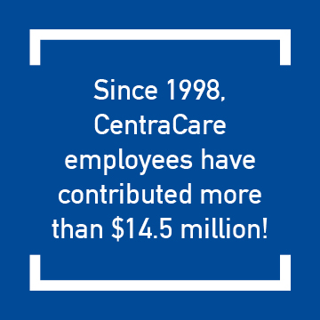
Convenient Giving Options
Give any dollar amount or 30/60/90 minutes per pay period via:
Payroll deduction
Credit Card
Cash or Check
Notes:
If you’re able, you can choose to give any dollar amount or 30/60/90 minutes of pay per pay period.
Every gift, in any amount matters and payroll deduction makes it easy.

Slide 9
Notes:
This graphic shows some employee answers to the question, “how do you feel after making a gift to the Employee Giving Campaign?”
Will you join your CentraCare teammates and help build healthier, stronger communities?

Slide 10
Notes:
Thank you for your time and for choosing to make a difference!

